Slide 1
ICD-10 CM Overview with Concentration on Neoplasms and Fracture
Elizabeth Kollai
RHIT, CCS-P, CHTS-TR
AHIMA Approved ICD-10 Trainer

Slide 2
Only 136 days left before ICD-10 CM
Are you ready?

Slide 3
ICD-10 CM Resources
2015 ICD-10-CM is available at http://www.cdc.gov/nchs/icd/icd10cm.htm or http://www.cms.hhs.gov/ICD10
2015 ICD-10-CM Index to Diseases and Injuries
2015 ICD-10-CM Tabular List of Diseases and Injuries
  Instructional Notations
2015 Official Guidelines for Coding and Reporting
2015 Table of Drugs and Chemicals
2015 Neoplasm Table
2015 Index to External Causes
2015 Mapping ICD-9-CM to ICD-10-CM and
ICD-10-CM to ICD-9-CM

Slide 4
Changes from ICD-9 CM
21 chapters instead of 17 chapters in ICD-9 CM
ICD-9 CM V and E supplemental codes are incorporated into the main ICD-10 CM codes
Injuries are grouped by site and then type instead of first by type as in ICD-9 CM
ICD-10-CM codes are alphanumeric and can be up to seven characters in length
ICD-10-CM added seventh characters for obstetrics, injuries, and external causes of injuries
ICD-10-CM added a placeholder X

Slide 5
New Features in ICD-10-CM
Combination codes for conditions and common symptoms or manifestations
E10.21, Type 1 diabetes mellitus with diabetic nephropathy
K50.112, Crohn's disease of large intestine with intestinal obstruction
Combination codes for poisonings and external causes
    T36.0X1D, Poisoning by penicillins, accidental (unintentional), subsequent encounter
    T42.4X5A, Adverse effect of benzodiazepines, initial encounter
Added laterality
  M94.211, Chondromalacia, right shoulder
  S40.259A, Superficial foreign body of unspecified shoulder, initial encounter

Slide 6
Added seventh-characters for episode of care
S06.0X1A, Concussion with loss of consciousness of 30 minutes or less, initial encounter
S52.132B, Displaced fracture of neck of left radius, initial encounter for open fracture Type I or II or initial encounter for open fracture NOS
Expanded codes (injuries, diabetes, alcohol and substance abuse, postoperative complications)
  E11.341, Type 2 diabetes mellitus with severe nonproliferative diabetic retinopathy with macular edema
  F14.221, Cocaine dependence with intoxication delirium
  Inclusion of trimesters in obstetrics codes (and elimination of fifth digits for episode of care)
    O10.012, Pre-existing essential hypertension complicating pregnancy, second trimester
    O99.013, Anemia complicating pregnancy, third trimester

Slide 7
Changes in time frames specified in certain codes
  Acute myocardial infarction—time period changed from 8 weeks to 4 weeks
Time frame for abortion versus fetal death changed from 22 weeks to 20 weeks
Added standard definitions for two types of “excludes” notes
  Excludes1 note indicates “not coded here.” The code being excluded is never used with the code. The two conditions cannot occur together.
B06, Rubella (German measles) has an Excludes1 of congenital rubella (P35.0)
  Excludes2 note indicates “not included here.” The excluded condition is not part of the condition represented by the code. It is acceptable to use both codes together if the patient has both conditions.
  J04.0, Acute laryngitis has an Excludes2 of chronic laryngitis (J37.0)

Slide 8
ICD-10 CM Conventions and Guidelines
http://www.cdc.gov/nchs/data/icd/ICD10cmguidelines_2015%209_26_2014.pdf
Section I. Conventions, general coding guidelines and chapter specific guidelines
Section II. Selection of Principal Diagnosis
Section III. Reporting Additional Diagnosis
Section IV. Diagnostic Coding and Reporting Guidelines for Outpatient Services

Slide 9
Chapter 2: Neoplasms (C00-D49)

Slide 10
Changes from ICD-9 CM
ICD-10-CM, the block of codes for in situ neoplasms is located before the block for benign neoplasms.
The addition in ICD-10-CM of a separate fifth character for extranodal and solid organ sites for lymphomas and Hodgkin's.
  ICD-9-CM included these sites with the fifth digit for unspecified site in codes for Hodgkin's disease, non-Hodgkin's lymphoma, peripheral, and cutaneous T-cell lymphomas.

Slide 11
Guidelines
To properly code a neoplasm it is necessary to determine from the record if the neoplasm is benign, in-situ, malignant, or of uncertain histologic behavior. If malignant, any secondary (metastatic) sites should also be determined.
Treatment directed at the malignancy
Treatment of secondary site
Coding and sequencing of complications
  Anemia associated with malignancy
  Anemia associated with chemotherapy, immunotherapy and radiation therapy
  Management of dehydration due to the malignancy
  Treatment of a complication resulting from a surgical procedure
Primary malignancy previously excised
Notes:
If the treatment is directed at the malignancy, designate the malignancy as the principal diagnosis.
Exception- if the patient admission/encounter is solely for the administration of chemotherapy, immunotherapy or radiation therapy, assign the appropriate Z51.--code as the first-listed or principal diagnosis, and the diagnosis or problem for which the service is being performed as a secondary diagnosis.

Slide 12
Admissions/Encounters involving chemotherapy, immunotherapy and radiation therapy
  Episode of care involves surgical removal of neoplasm
  Patient admission/encounter solely for administration of chemotherapy, immunotherapy and radiation therapy
  Patient admitted for radiation therapy, chemotherapy or immunotherapy and develops complications
Admission/encounter to determine extent of malignancy
Symptoms, signs, and abnormal findings listed in Chapter 18 associated with neoplasms
Admission/encounter for pain control/management
Malignancy in two or more noncontiguous sites
Disseminated malignant neoplasm, unspecified
Malignant neoplasm without specification of site

Slide 13
Sequencing of neoplasm codes
  Encounter for treatment of primary malignancy
  Encounter for treatment of secondary malignancy
  Malignant neoplasm in a pregnant patient
  Encounter for complication associated with a neoplasm
  Complication from surgical procedure for treatment of a neoplasm
  Pathologic fracture due to a neoplasm
Current malignancy versus personal history of malignancy
Leukemia , Multiple Myeloma, and Malignant Plasma Cell Neoplasms in remission versus personal history
Aftercare following surgery for neoplasm
Follow-up care for completed treatment of a malignancy
Prophylactic organ removal for prevention of malignancy
Malignant neoplasm associated with transplanted organ

Slide 14

Case 1
The diagnosis for this 61-year-old female patient is small cell carcinoma of the right lower lobe of the lung with metastasis to the intrathoracic lymph nodes, brain, and right rib. What diagnosis codes are assigned?
© 2015

Slide 15
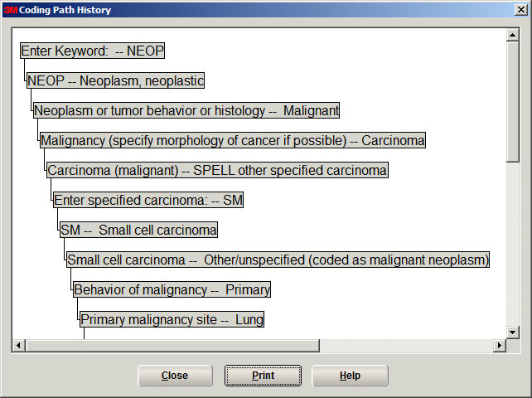

Slide 16
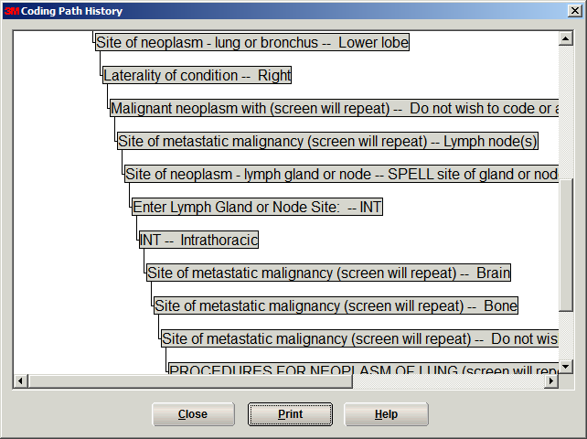

Slide 17
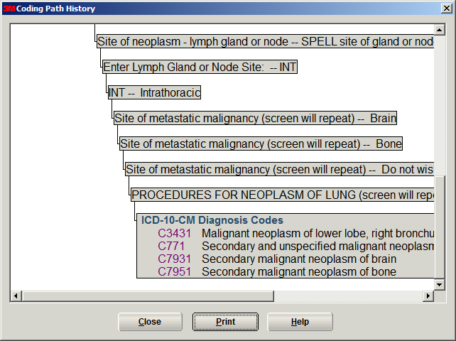

Slide 18
Answer
C34.31 Malignant neoplasm of lower lobe, right bronchus or lung
C77.1 Secondary and unspecified malignant neoplasm of intrathoracic lymph nodes
C79.31 Secondary malignant neoplasm of brain
C79.51 Secondary malignant neoplasm of bone
© 2015

Slide 19
Case 2
This female patient with terminal carcinoma of the central portion of the right breast, metastatic to the liver and brain, was seen for dehydration and chronic intractable neoplasm-related pain. Patient was rehydrated with IVs and given IV pain medication with no treatment directed toward the cancer. What diagnosis codes are assigned?
© 2015

Slide 20
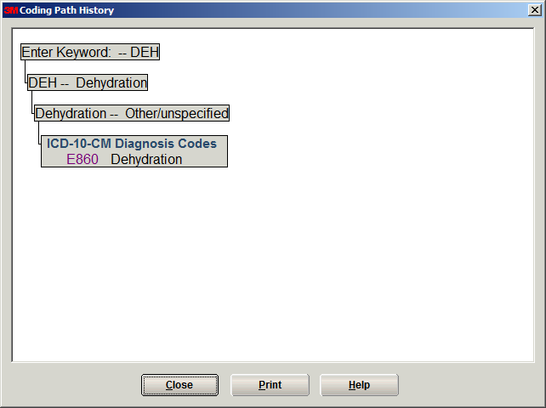

Slide 21
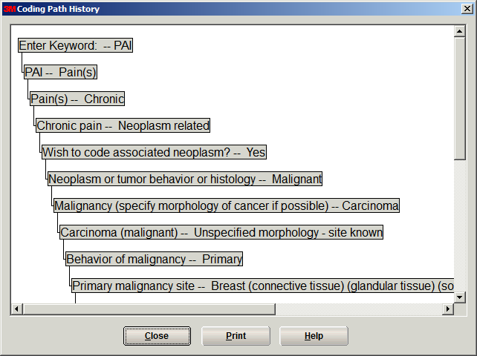

Slide 22
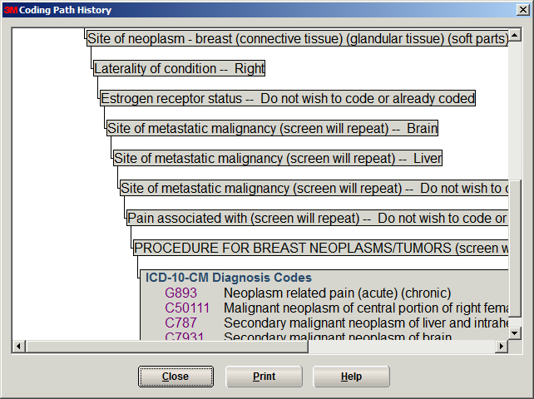

Slide 23
Answer
E86.0 Dehydration
G89.3 Neoplasm related pain (acute) (chronic)
C50.111 Malignant neoplasm of central portion of right female breast
C79.31 Secondary malignant neoplasm of brain
C78.7 Secondary malignant neoplasm of liver and intrahepatic bile duct
© 2015

Slide 24
Fractures in
Chapter 19: Injury, poisoning and certain other consequences of external causes (S00-T88)

Slide 25
Changes from ICD-9 CM related to fractures
Injuries are grouped by body part instead of by injury type
Greater specificity
  Laterality
  Type of fracture
  Location of fracture
  Displacement status
  Healing status
Seventh character indicates initial, subsequent, sequel
  Additional seventh characters for Gustilo open fracture classification

Slide 26
Guidelines
Application of 7th Characters in Chapter 19
Coding of Traumatic Fractures
  Initial vs. Subsequent Encounter for Fractures
  Multiple fractures sequencing

Slide 27
Case 1
This patient is seen for increased pain in her ankle. She has previous trimalleolar fracture of the left ankle. After evaluation she was found to have a nonunion of her left trimalleolar fracture. What is the correct diagnosis code(s)? (Do not assign external cause codes.)
© 2015

Slide 28
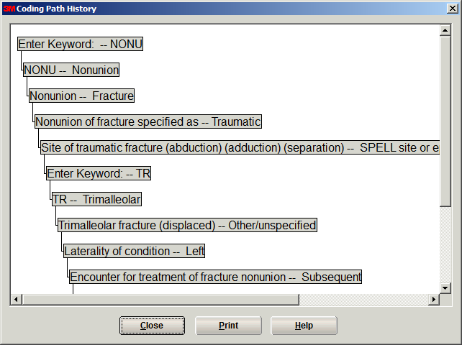

Slide 29
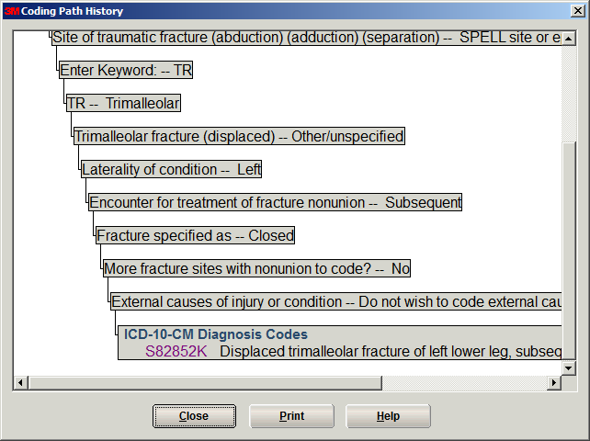

Slide 30
Answer
S82.852K Displaced trimalleolar fracture of left lower leg, subsequent encounter for closed fracture with nonunion
© 2015

Slide 31
Case 2
This young man is seen today with right forearm fracture. This is found to be a displaced, compound comminuted fracture of the radial shaft. It is a type II open fracture. What is the correct diagnosis code? (Do not assign the external cause code.)
© 2015

Slide 32
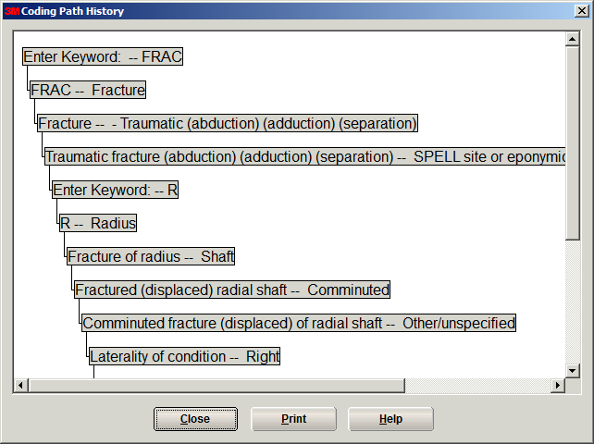

Slide 33
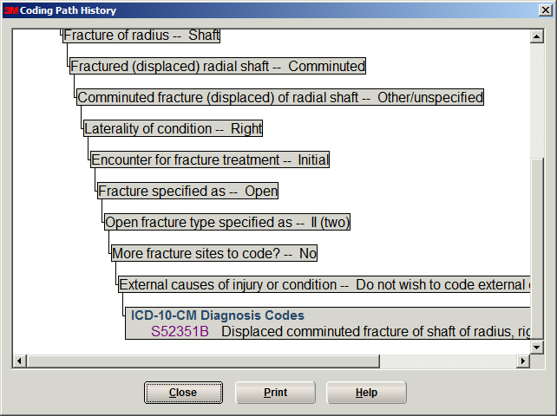

Slide 34
Answer
S52.351B Displaced comminuted fracture of shaft of radius, right arm, initial encounter for open fracture type I or II
© 2015

Slide 35
Questions?

