Slide 1

Hospice as a Care Partner

Slide 2

Hospice defined:
Hospice services are forms of palliative medical care and services designed to meet the physical, social, psychological, emotional and spiritual needs of terminally ill individuals and their families.

Slide 3
Conditions of Participation
42CFR Part 418 establishes hospice care
Patient Rights
Comprehensive assessments
Patient Care Planning and coordination by the IDG (Interdisciplinary Group), attending physician and the patient

Slide 4
Election of services
Terminal diagnosis of less than 6 months if illness follows it normal course
Patient is not seeking aggressive treatment
Notice of Election
Initial Certification by both attending physician and medical director
DNR is not required

Slide 5
Certification and Face to Face
Recertification 90-90-60 by medical director
3rd or later benefit period requires Face to Face with medical director or ARNP
Nursing visit at a minimum of every 14 days

Slide 6
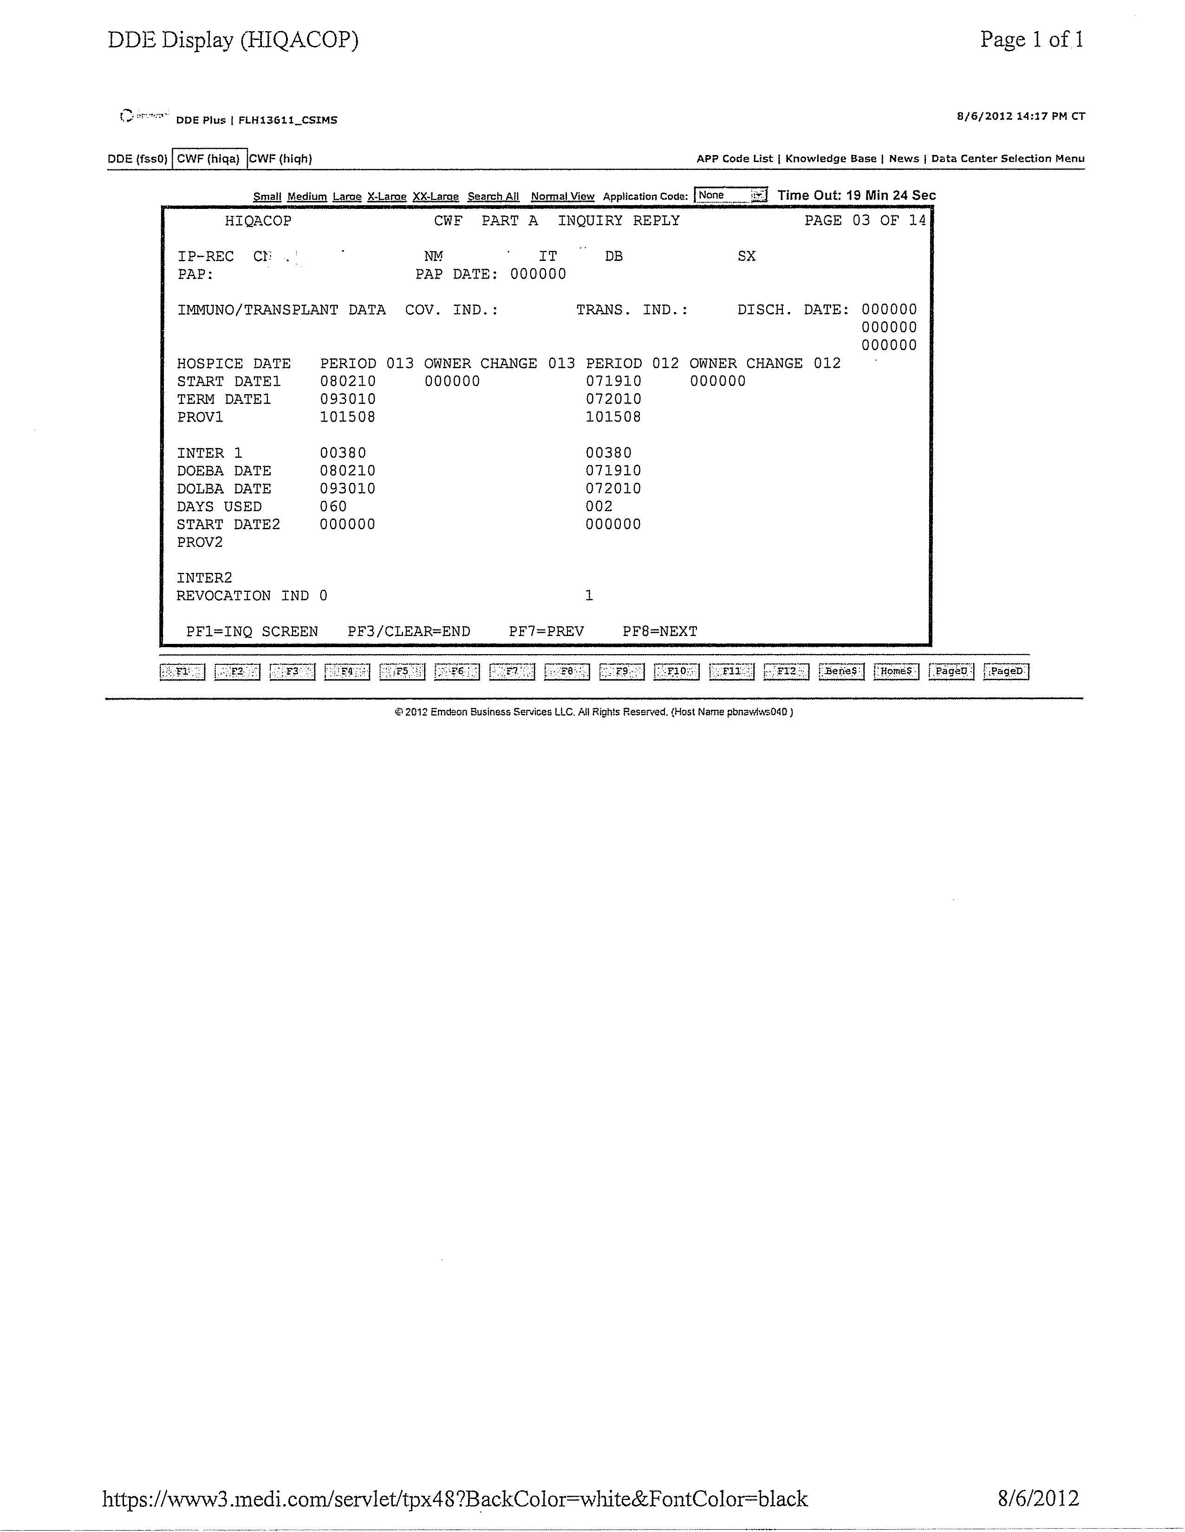

Slide 7
Diagnosis
Terminal and related diagnoses determined upon admission
LCD’s (Local Coverage Determinations)
HIV
Neurological Conditions
Liver disease
Renal Care
Alzheimer’s and related disorders
Cardiopulmonary
Adult Failure to Thrive

Slide 8
Diagnosis continued
Coders review all admits; hospital stays; changes in conditions
Related vs Unrelated
Not always immediately evident such as:
- Altered Mental Status
- Chest pain
- Shortness of breath
- Falls (what happened to result in fall)

Slide 9
Levels of Care
Routine Home Care
Revenue code 651
Continuous Care – minimum 8 hours; at least 51% by nurse
Revenue code 652
Respite Care – relief for caregiver at inpatient facility
Revenue code 655
General Inpatient Care – hospital, nursing home, hospice facility
Revenue code 656

Slide 10
Additional Revenue Codes
Physician Services - hospice or consulting
Revenue code 657
Room and Board – nursing home
Revenue code 658
Bed hold – nursing home R&B when patient is admitted to hospital
Revenue code 185

Slide 11
Location Codes
Created to show where patients are receiving services
Q5001 – home
Q5002 – ALF
Q5003 – nursing facility (nonskilled)
Q5004 – Skilled nursing facility
Q5005 – Inpatient hospital
Q5006 – Inpatient hospice facility
Q5007 – Long term care facility
Q5008 – Psychiatric facility
Q5010 – Routine, CC at hospice facility

Slide 12
Visits
Visits for Nurses, Social Workers, HHA, physicians, therapists and SW phone calls are reportable to Medicare
GIP visits are reported each visit accumulated by week
RHC, Respite and CC visits are reported in 15 minute increments per day by discipline

Slide 13
Claims Submission
UB04
Medicare Part A
Consecutive billing
Bill type:
First digit is 8
Second digit is 1 for Non-hospital based or 2 for hospital based
Third digit – frequency
A – benefit period initial election
B – termination/revocation of previous claim
C- change of provider
D- void/cancel hospice election
Digits 1 – 8 utilized as with other providers

Slide 14
Hospice and Managed Care
42 CFR 417.585 Special Rules:Hospice Care
Patient may maintain their Medicare HMO plan
For services unrelated to hospice diagnosis and/or services in same month after hospice termed provider bills Medicare as primary
Medicare HMO is billed for co-pay or deductible with the Medicare EOB

Slide 15
Attending vs Consulting Physician
Attending physician is identified by the patient as having the most significant role in determination and delivery of the individual’s medical care
Consulting physician is whose opinion or advice regarding evaluation/management of a specific problem is requested

Slide 16
Attending Physician continued
Office visits for hospice patient directly related to hospice diagnosis are billed to Medicare/Medicaid with a GV modifier to indicate physician as attending
Non-related labs, treatments or therapies are billed to Medicare/Medicaid with GW modifier
Related labs, treatments or therapies are billed to the hospice
Patients who are Insurance or Self Pay are payable by the hospice ONLY if services are received at home

Slide 17
Consulting Physician billing
Any office visit, labs, therapies or treatments related to the hospice diagnosis and in the plan of care are billed to the hospice
Unrelated services or items are billed to Medicare/Medicaid with a GW modifier
**Unrelated hospital stay billed with Condition code 07

Slide 18
Care Plan Oversight
Attending physician supervision of care for hospice patient billable to Medicare Part B on 1500 form
CPT G0182
30 minutes or more per calendar month
Activities to coordinate care
Review of charts, treatment plans, labs, etc
Telephone or face to face discussions with hospice staff or pharmacist (not patient/family)

Slide 19
CPO continued
Item #23 must contain Medicare provider number of hospice
Use first and last date of care plan services not necessarily of the month
Must have billed for a face to face encounter within the past 6 months
Current reimbursement $106.96

Slide 20
Cindy Sims, CPAM
Director, Reimbursement
Suncoast Hospice
727-523-3369
cindysims@thehospice.org

